Slide 1
Overview

Slide 2



Shopcrawl: Make Shopping A Party
We chose this name because it calls to mind a pub crawl, an existing activity that creates social connections between customers and helps create foot traffic for local businesses
Value prop: Make shopping a party
  We aim to push chore shopping from being lonely, time consuming, unenjoyable to a social fun experience by making it into a “party” and chore shopping with a collection of your friends

Slide 3
Problem and Solution
Our target user is a recent college graduate who is learning how to shop for necessary items such as groceries. The problem we intend to solve is that such chore shopping tends to be boring or intimidating to inexperienced shoppers. We intend to solve this problem by making chore shopping a social experience, specifically through pop-up events, similar to pub crawls or cars-and-coffee, inviting shoppers to explore new stores each week.

Slide 4
Market Research

Slide 5

Watevent
“Explore Amazing Events Nearby.”
“Largest selection of Local Fun & Live Events.”
What Worked for Our Problem Space:
Allows users to discover local businesses, especially places you can do things together with friends.
Offers exclusive discounts to listed events.
Team manually checks each event to ensure accuracy and completeness.
What doesn’t work:
Used to discover events such as music and festivals, not shopping.
Does not facilitate the creation of events (by stores), only discovery.

Slide 6

LocallyLive
“Discovering and supporting Local Businesses & Organizations has never been easier!”
“LocallyLive provides a safe and reliable platform where you can find daily deals, attractions, and exciting happenings in the community you’re in!”
What Worked for Our Problem Space:
Deal finding capabilities which helped users feel confident exploring new locations
Local businesses sign up to create listings on the app
A live map feature which allows uses to see the proximity of all the stores in the area
What doesn’t work:
App includes restaurants, activities, attractions, and more
Users say the entire app “feels like an advertisement”
Local stores have to pay for a yearly subscription

Slide 7

CoCarting
“CoCarting makes shopping social!”
“Shop Together Anywhere, Anytime.”
“Create Your Personalized WishList and Shop Better Together.”
What Worked for Our Problem Space:
Users can add items to purchase, vote on choices, and chat with friends and family in real-time.
Makes group purchases and sharing of ideas easier.
Accommodates all shopping needs: gift registries, grocery lists, event planning, or personal shopping
What doesn’t work:
Online only experience, no physical, social aspect.
You can only browse items from “top retailers” like Amazon or Walmart.
Users have concerns about website security, and a risk of getting scammed easily.

Slide 8

Eventbrite
“Discover the Best Local Events & Things to Do.”
“The future of events is here.”
What Worked for Our Problem Space:
Users can discover events such as holiday markets, vendor shows, or craft fairs organized by local businesses.
Can keep track of how many users are signed up to visit a store at a particular time.
What doesn’t work:
Local businesses must organize their own fairs; unrelated businesses cannot be grouped as one activity.
Focus on one time event ticketing and promotion.
Majority of listed events are unrelated to a shopping experience.

Slide 9
What we learned
Key insights:
Most event apps help users find users local businesses but not enable them to experience them together
Occasional events like those on Eventbrite generate short-term spikes but fail to build lasting routines.
Apps help making shopping a community, but this only exists online and does not extent to the real world

Slide 10
Values in Design

Slide 11
Direct Stakeholders
Shoppers who participate in shop crawl events
Needs: clear route and schedule, accessibility, transportation to and from locations, identification of who is in the group
Owners and employees of stores that host events
Needs: what people want to buy from their store, when they are going to be there, not to be disruptive
We ask that they offer bulk discount given the large amount of people that will be coming to the store

Slide 12
Indirect Stakeholders
Neighbors and residents near the route
Gains: Nearby businesses that are not using Shopcrawl may still benefit from increased traffic
Losses: Area may become crowded, noisy, and chaotic
Non-crawl shoppers who typically shop at these stores
Gains: Also benefit from the discounts
Losses: Their go-to stores— or possibly the only stores that they can go to— become crowded, and items may be sold out

Slide 13

Tarot Card: The Radio Star
What if our product becomes successful?
Non-participating merchants will bear the cost
  Value tension: Ensuring equitable opportunity for stores vs. value of using the stores with the best deals and ease of repeating the stores
To resolve tension:
Include a variety of stores and locations to give an opportunity to most stores in the neighborhood
Constant monitoring of our impact in local communities through interviews, studies, research

Slide 14

Tarot Card: The Backstabber
What could cause people to lose trust in our product?
Pay-to-play accusations: what if stores are paying to be included in crawls? This decreases equity among our potential customers
Unsafe: bad actors participating in the pub crawl, harassment
Selling or leaking users’ location data
To resolve this distrust:
Don’t collect user data at all
Safety ratings

Slide 15
Tasks

Slide 16
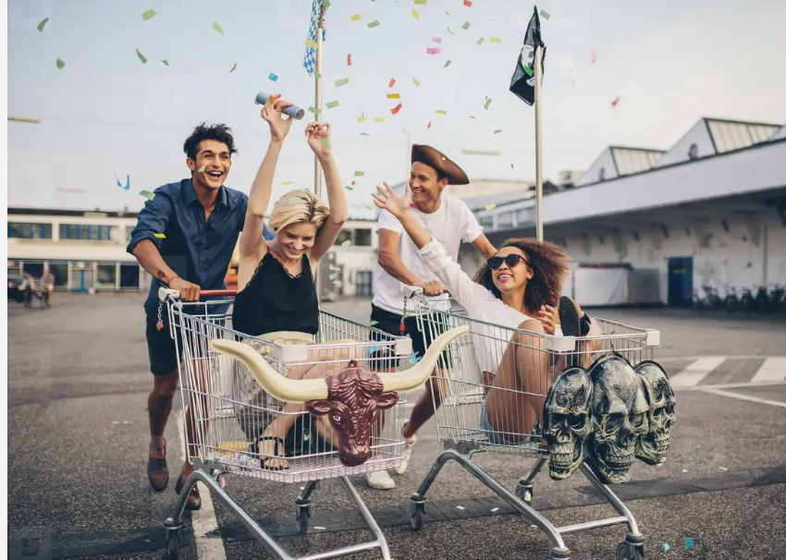
Simple task
Ash gets bored after work. He wants to have fun, but he has things to do. He wants to have fun while doing his chores.
The goal for every shop crawls user is to enjoy chore shopping by making it social
0:35

Slide 17
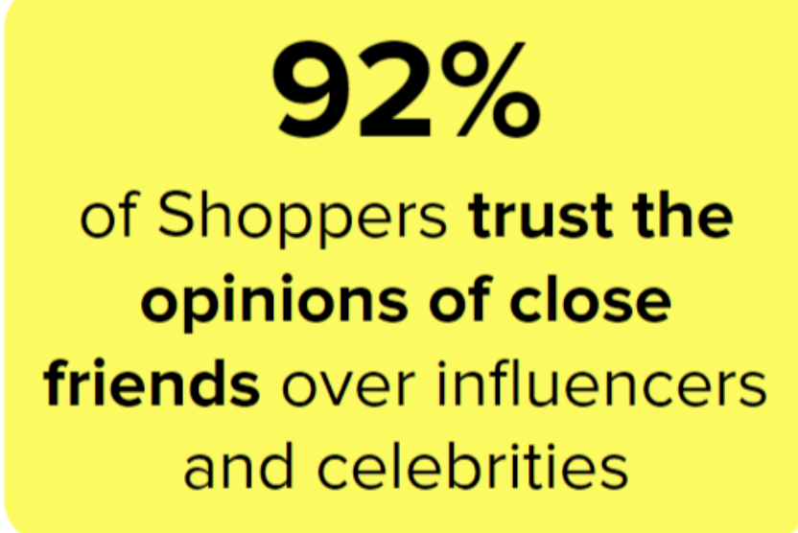
Moderate task
Ash has a lot of things to buy for his apartment. He doesn’t know what to buy, but trusts his friends opinions. He wants to buy the things his friends recommend but needs to see it at the store first.
By shopping with friends and like minded people, many of shop crawls users can get feedback and suggestions on what they are buying
1:05

Slide 18

Complex task
Monica had just moved to a new city and does not know many people. Due to her busy job, she wants to be socializing at all times, even when she has to do mundane tasks such as chores.
Our most core users are people who want to meet new people and explore more places. By being able to socialize during chores, you can make it easier to move somewhere and make friends
1:30

Slide 19
Storyboard & Video

Slide 20
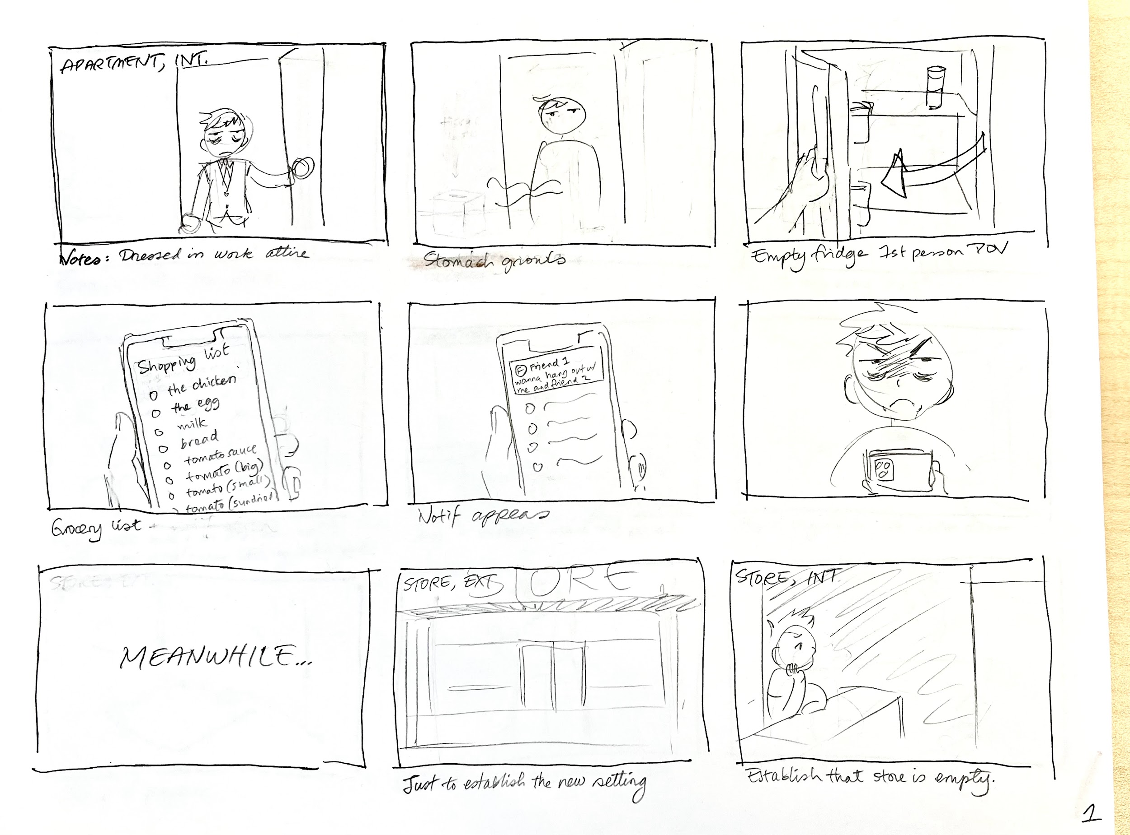

Slide 21
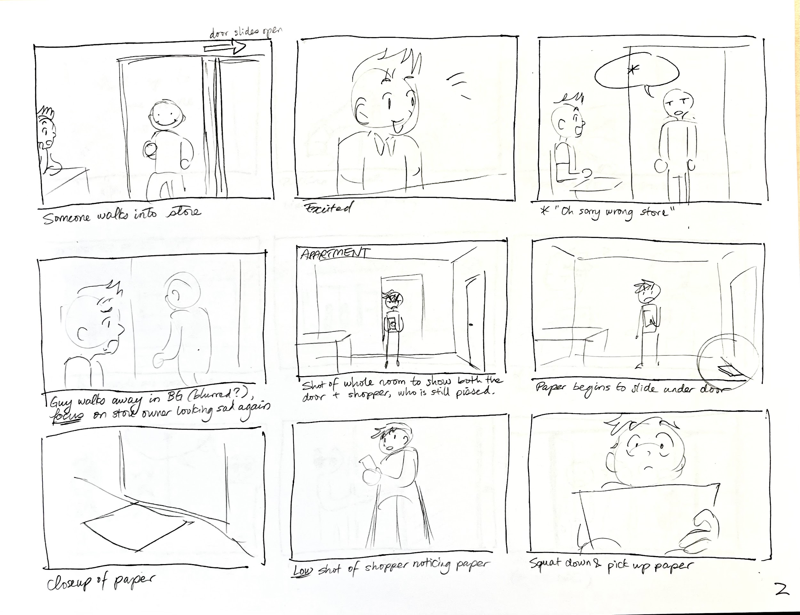

Slide 22
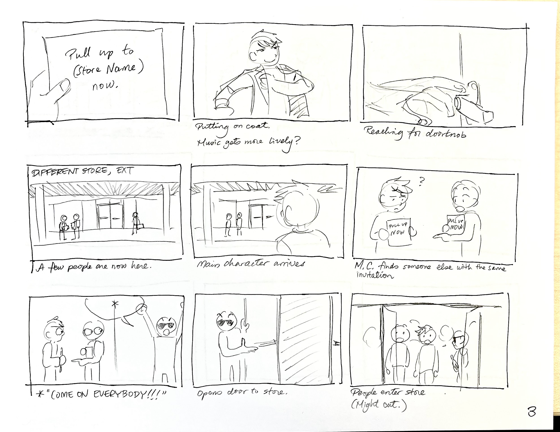

Slide 23
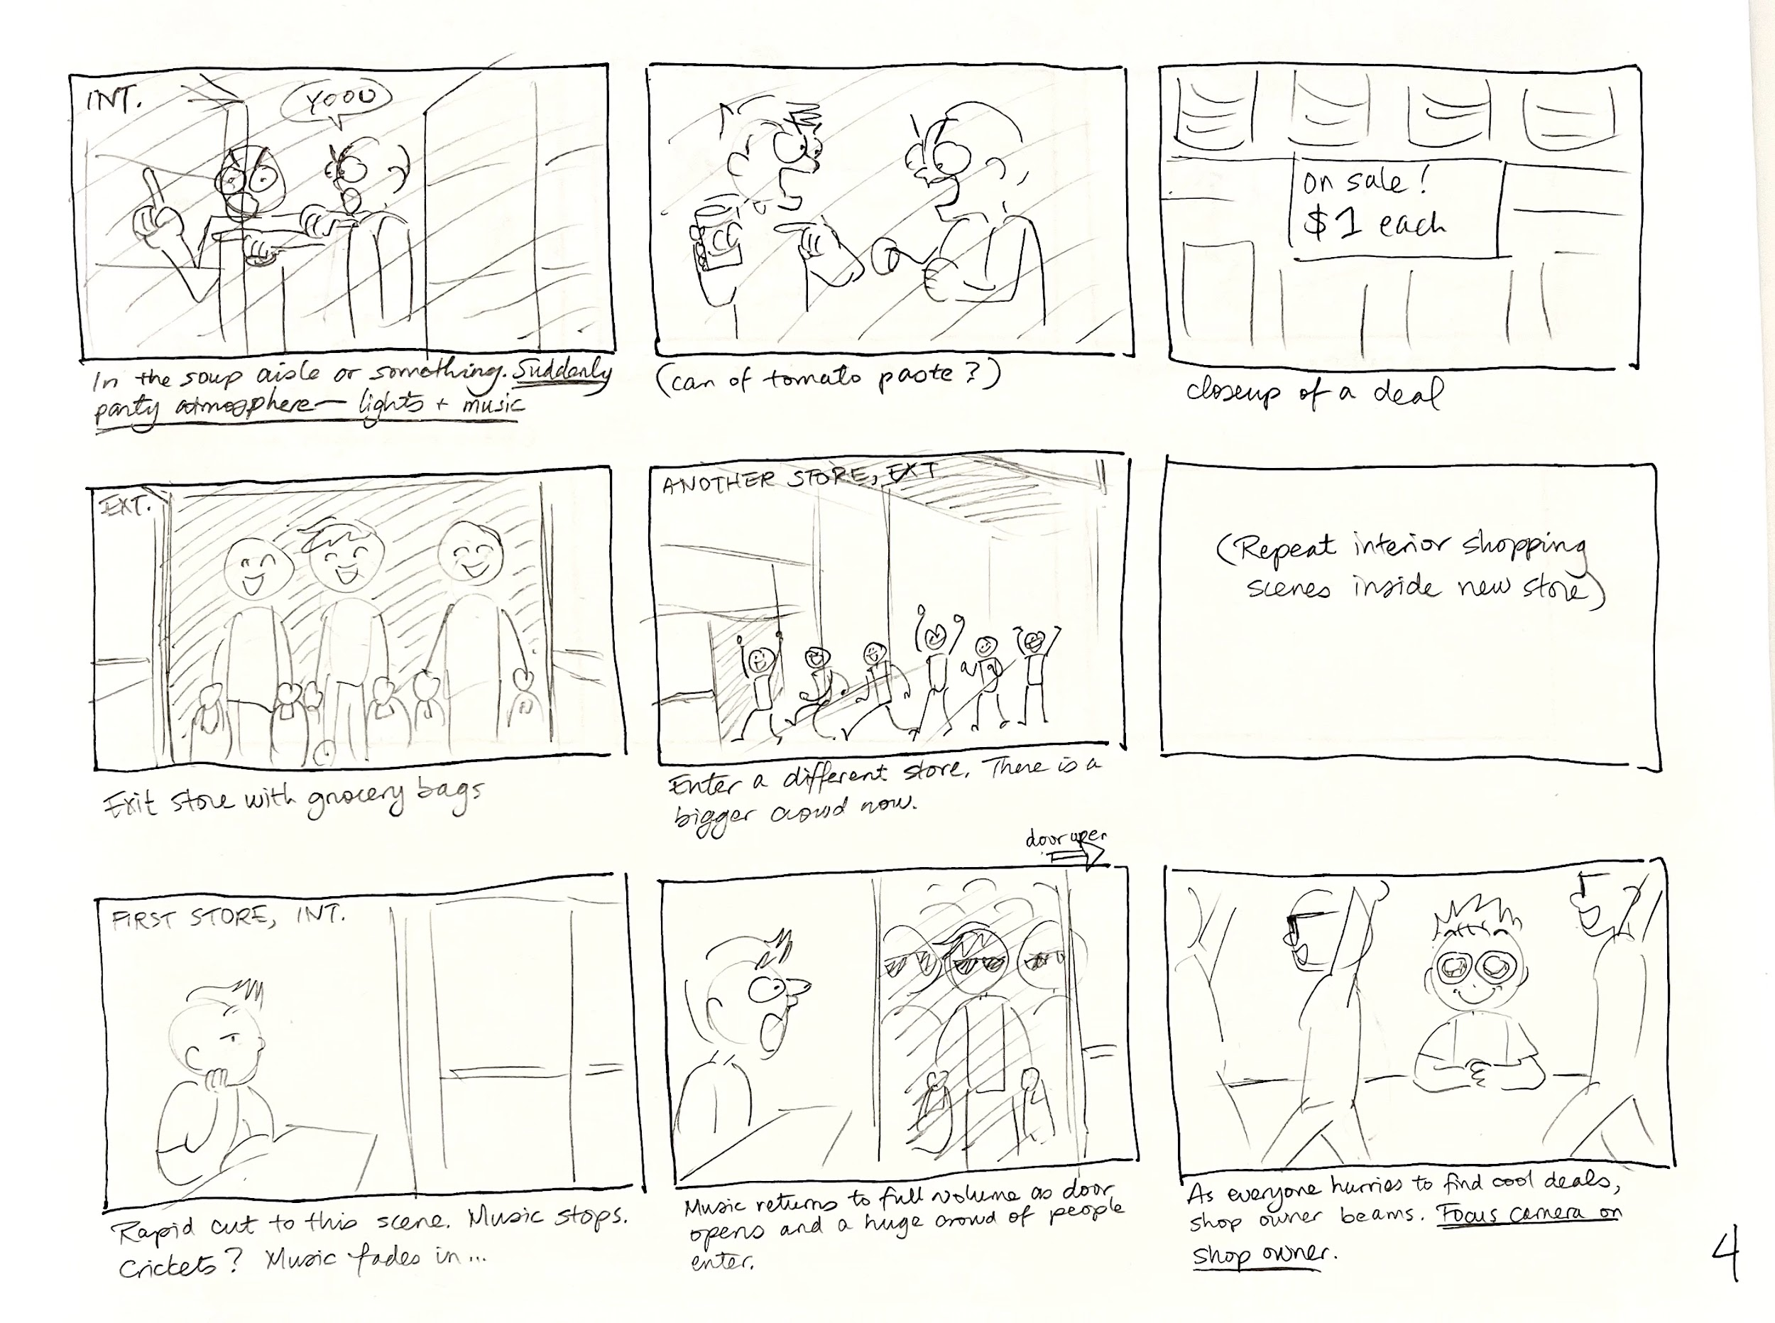

Slide 24
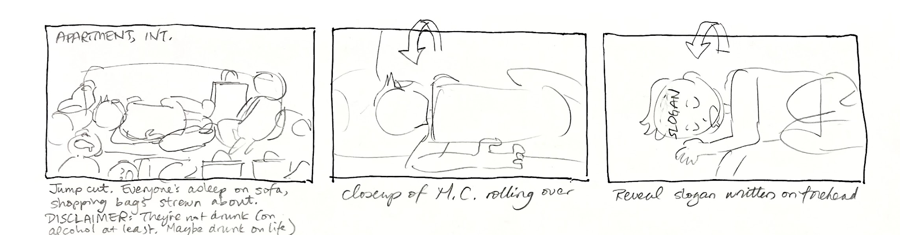

Slide 25
link to video

Slide 26
Appendix?

